Slide 1

Basics of Neural Network Programming
Binary Classification
deeplearning.ai

Slide 2
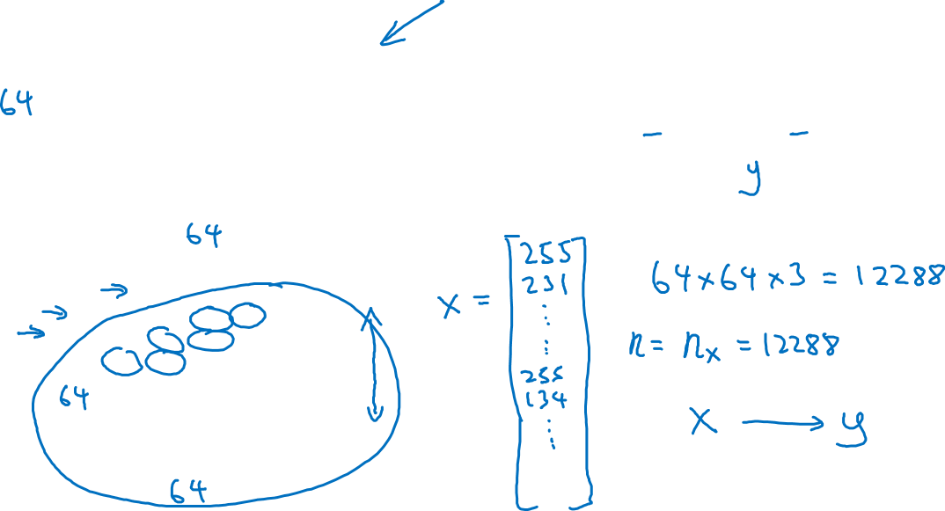
Binary Classification
1 (cat) vs 0 (non cat)
Blue
Green
Red

Slide 3
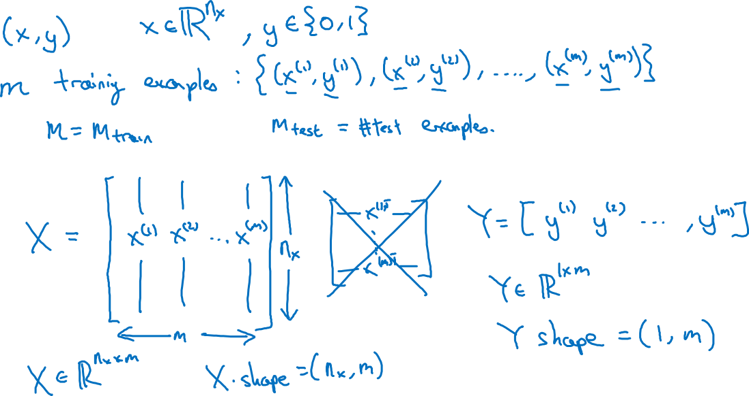
Notation

Slide 4
Basics of Neural Network Programming
Logistic Regression
deeplearning.ai

Slide 5
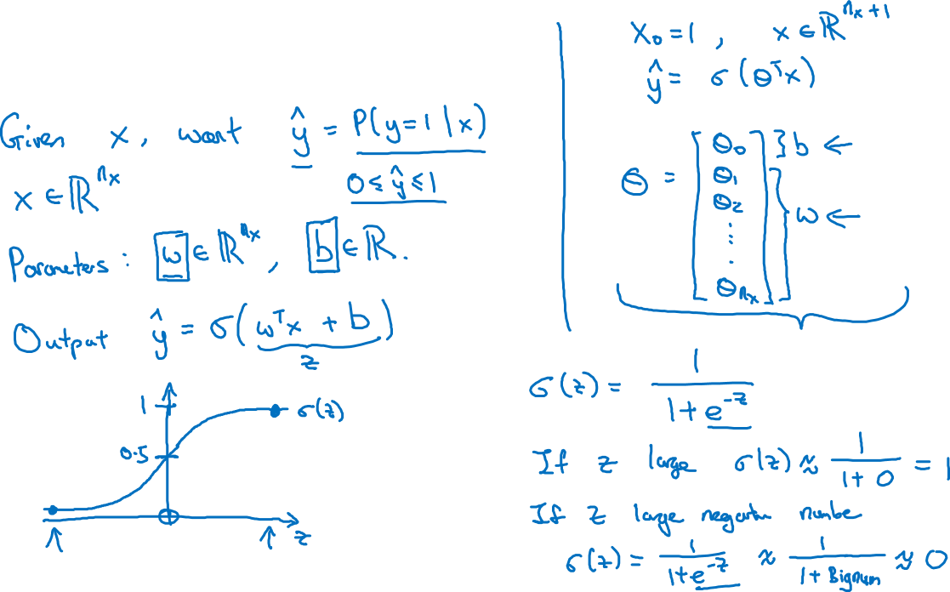
Logistic Regression

Slide 6
Basics of Neural Network Programming
Logistic Regression
cost function
deeplearning.ai

Slide 7
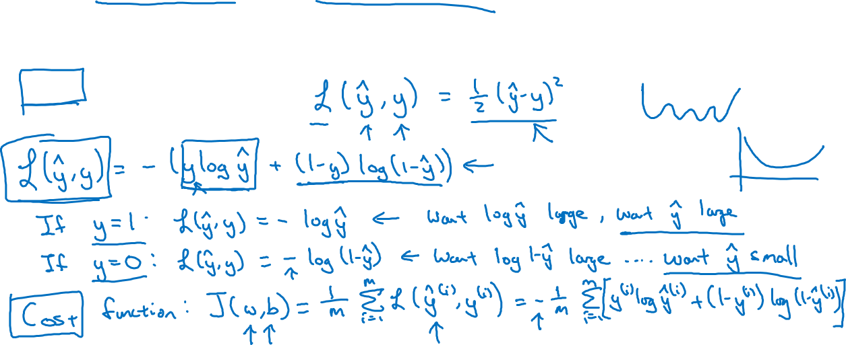
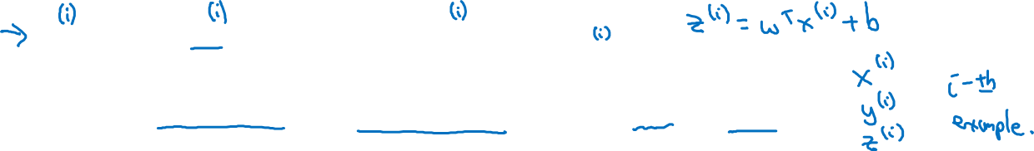
Logistic Regression cost function
$\hat{y} = σ\left(w^{T}x +b\right)$, where $σ\left(z \right)=\frac{1}{1+e^{−z}}$
Given $\left\{{(x}^{(1)},y^{(1)}\text{)}\text{,}\text{…}\text{,}{(x}^{(m)},y^{(m)}\text{)}\right\},$want ${\hat{y}}^{(i)}≈y^{\left(i\right)}$.
Loss (error) function:

Slide 8
Basics of Neural Network Programming
Gradient Descent
deeplearning.ai

Slide 9
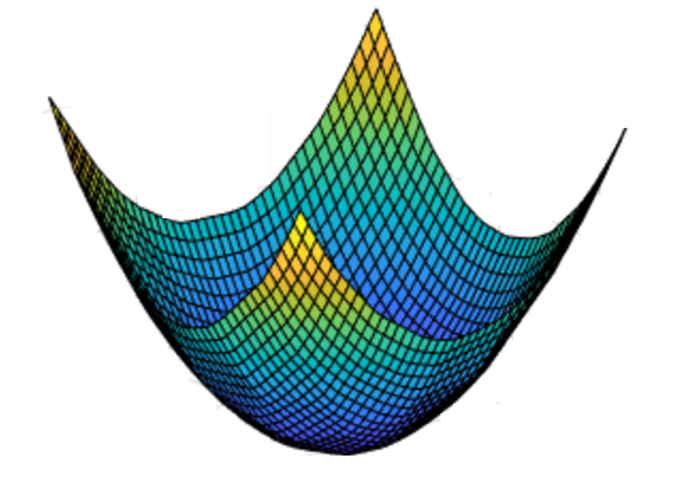
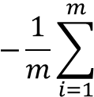
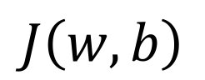

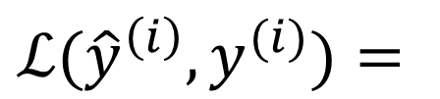
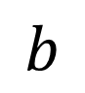
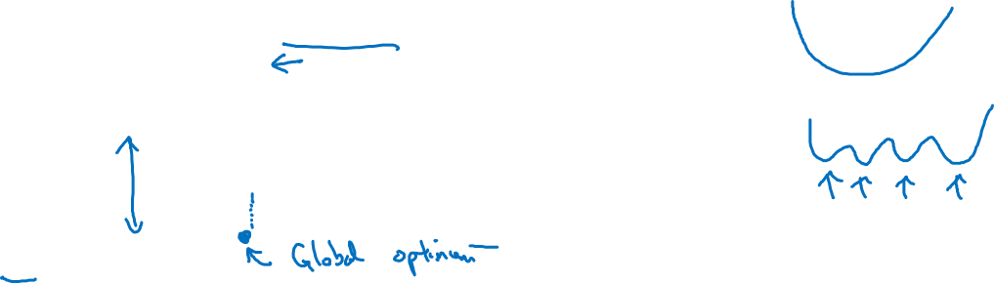
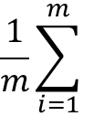
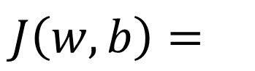


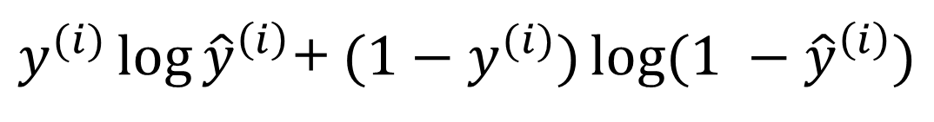

Gradient Descent
Recap: $\hat{y}= σ\left(w^{T}x+b\right)$, $σ\left(z\right)=\frac{1}{1+e^{−z}}$
$$\frac{1}{m}\sum_{i=1}^{m}{ }$$
$ℒ({\hat{y}}^{\left(i\right)},y^{(i)})$ $=$
$$−\frac{1}{m}\sum_{i=1}^{m}{ }$$
$$J\left(w,b\right)=$$
$y^{(i)}\log{{\hat{y}}^{\left(i\right)}}$+ $({1−y}^{(i)})\log{(1 −{\hat{y}}^{\left(i\right)})}$
Want to find $w,b$ that minimize $J\left(w,b\right)$
$$J\left(w,b\right)$$
$$b$$
$$w$$

Slide 10

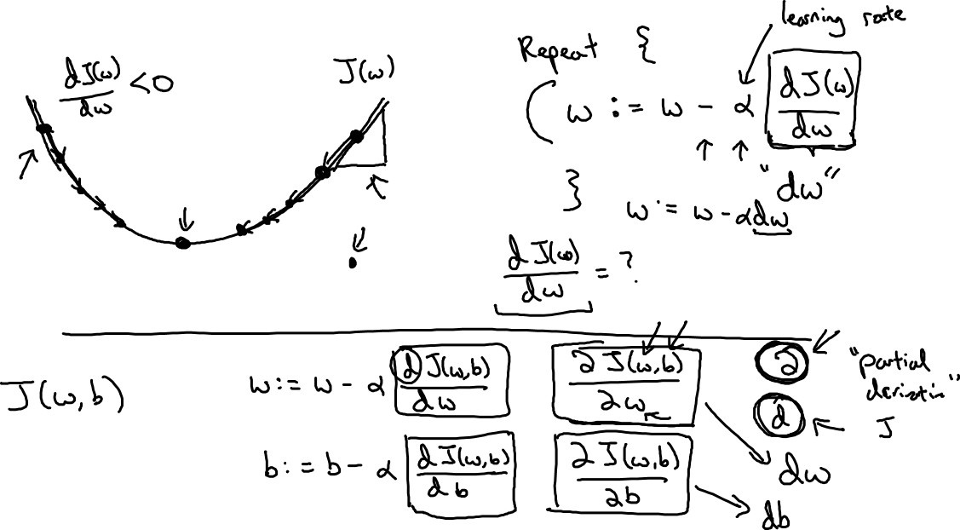
Gradient Descent
$$w$$

Slide 11
Basics of Neural Network Programming
Derivatives
deeplearning.ai

Slide 12
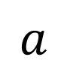
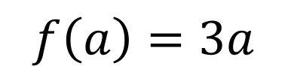
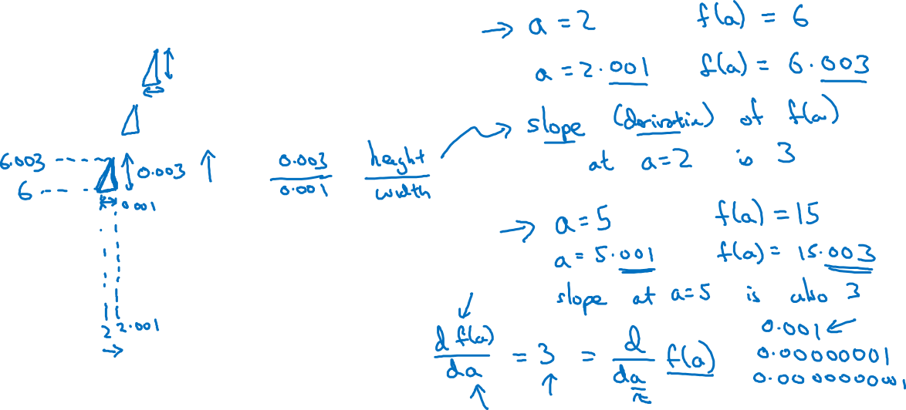
Intuition about derivatives
$$f\left(a\right)=3a$$
$$a$$

Slide 13
Basics of Neural Network Programming
More derivatives examples
deeplearning.ai

Slide 14
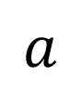
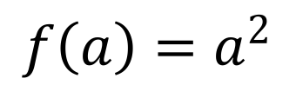
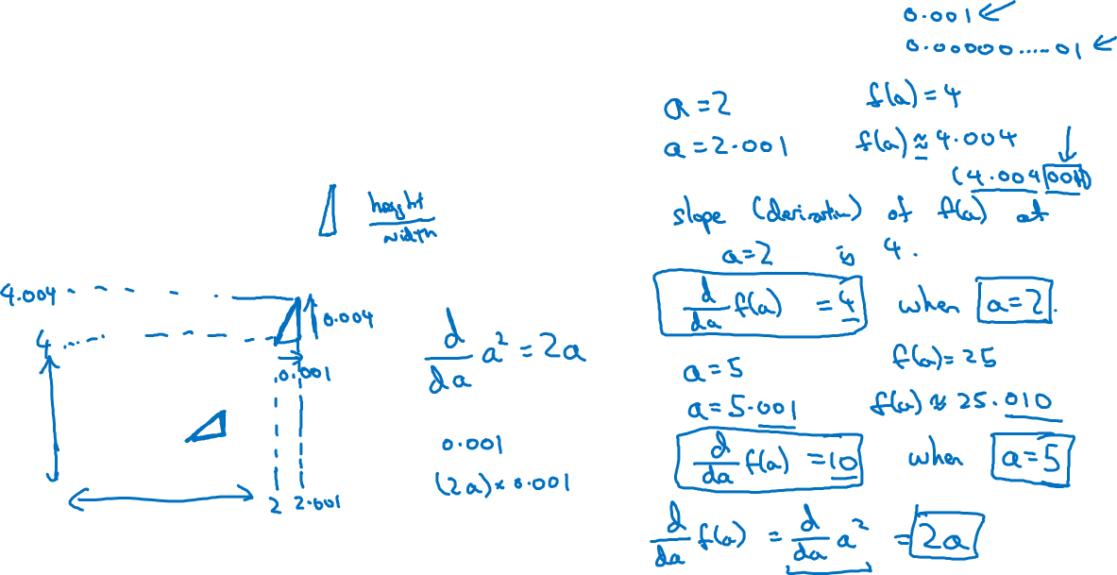
Intuition about derivatives
$$f\left(a\right)=a^{2}$$
$$a$$

Slide 15
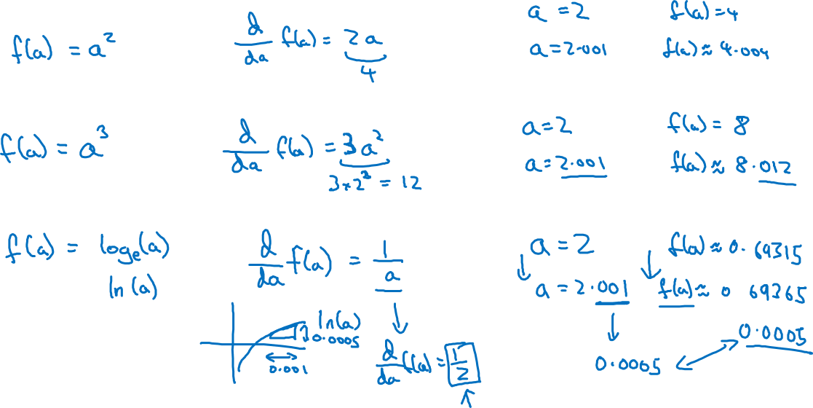
More derivative examples

Slide 16
Basics of Neural Network Programming
Computation Graph
deeplearning.ai

Slide 17
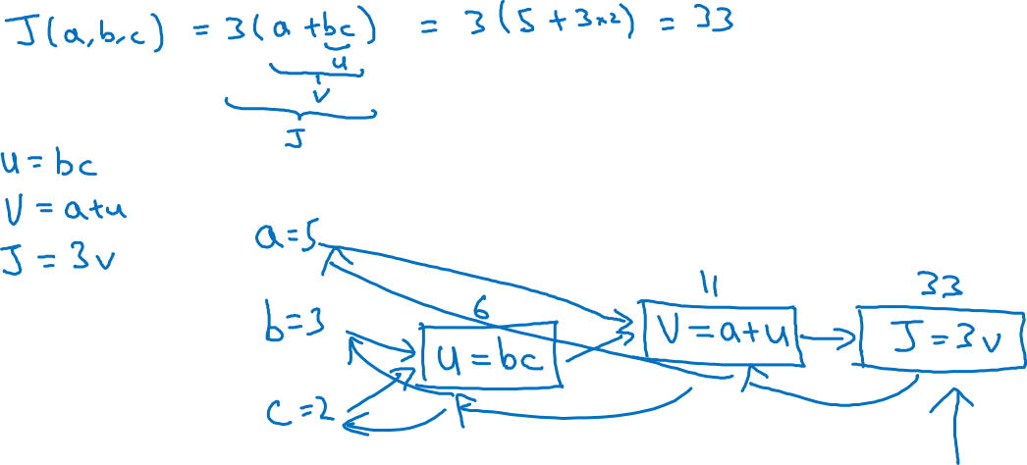
Computation Graph

Slide 18
Basics of Neural Network Programming
Derivatives with a Computation Graph
deeplearning.ai

Slide 19
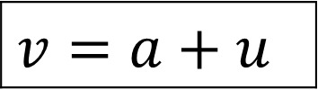
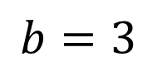
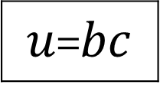
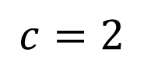
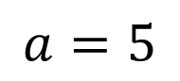
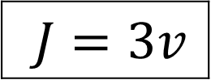
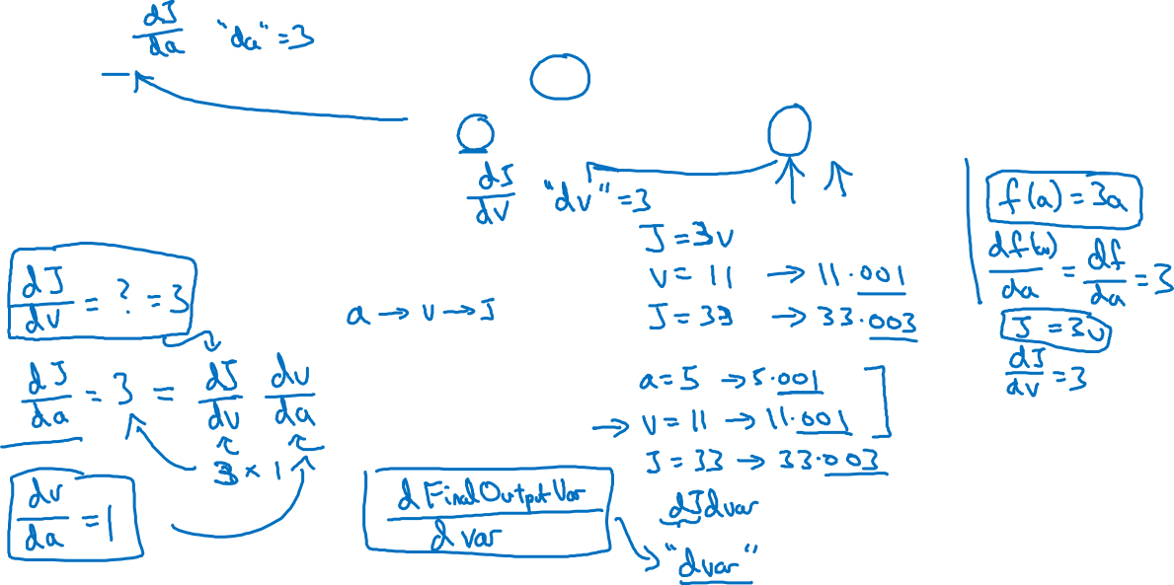
Computing derivatives
$$a=5$$
11
33
$$b=3$$
6
$$v=a+u$$
$J=3v$
$u$=$bc$
$$c=2$$

Slide 20
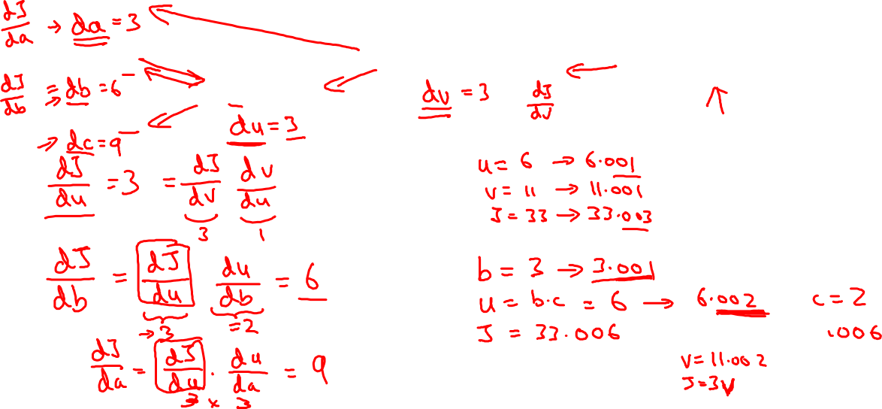
Computing derivatives
$$a=5$$
11
33
$$b=3$$
6
$$v=a+u$$
$J=3v$
$u$=$bc$
$$c=2$$

Slide 21
Basics of Neural Network Programming
Logistic Regression
Gradient descent
deeplearning.ai

Slide 22
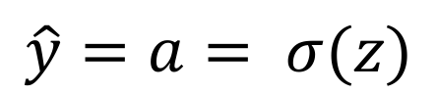
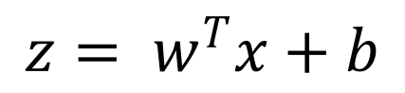
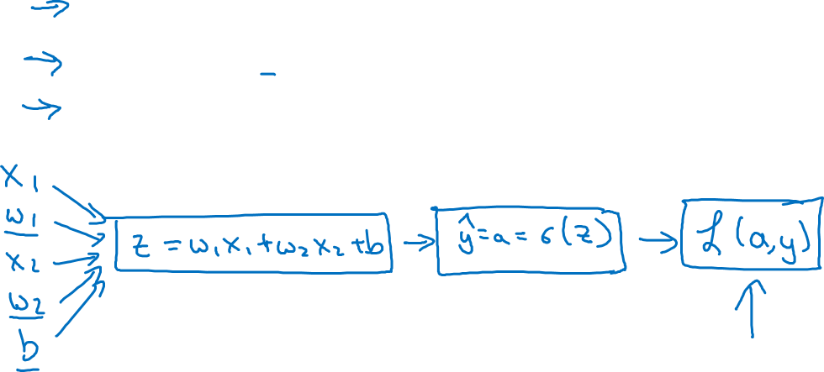
Logistic regression recap
$$z= w^{T}x+b$$
$$\hat{y}=a= σ(z)$$
$$ℒ\left(a,y\right)=−(y\log{(a)+(1−y)\log{(1−a))}}$$

Slide 23
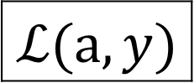
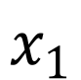
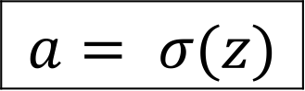
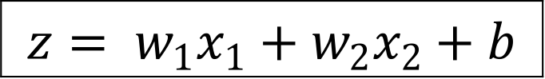
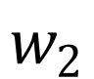
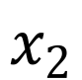
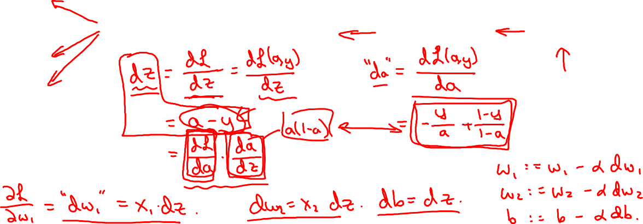
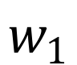
Logistic regression derivatives
$$x_{1}$$
$$w_{1}$$
$$x_{2}$$
$$z= w_{1}x_{1}+w_{2}x_{2}+b$$
$$a= σ(z)$$
$$ℒ(a,y)$$
$$w_{2}$$
b

Slide 24
Basics of Neural Network Programming
Gradient descent
on m examples
deeplearning.ai

Slide 25
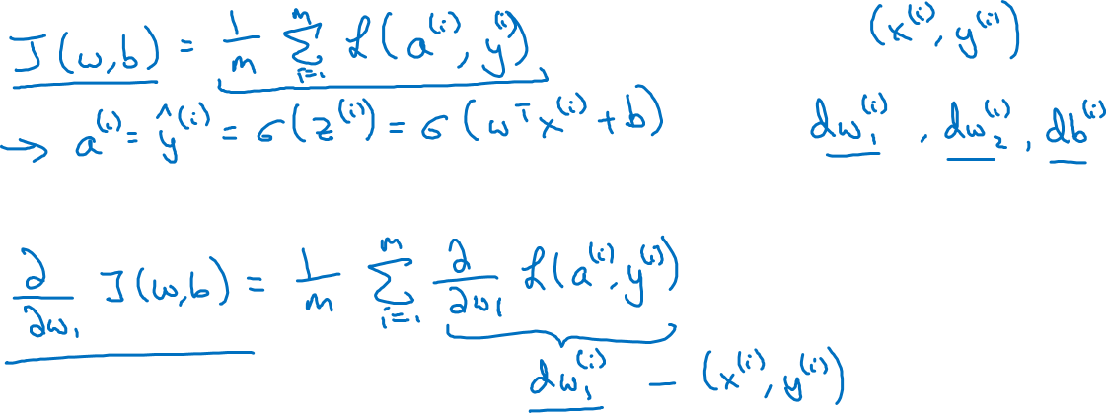
Logistic regression on m examples

Slide 26
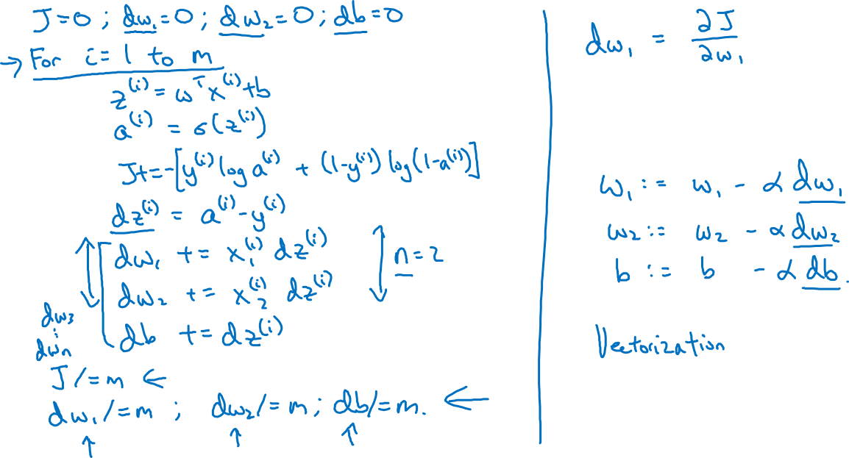
Logistic regression on m examples

Slide 27
Basics of Neural Network Programming
Vectorization
deeplearning.ai

Slide 28
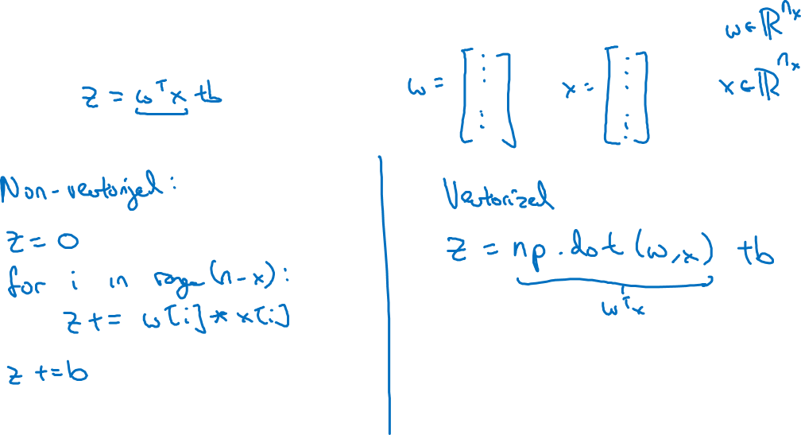
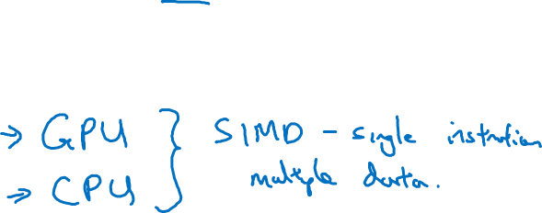
What is vectorization?

Slide 29
Basics of Neural Network Programming
More vectorization
examples
deeplearning.ai

Slide 30
Neural network programming guideline
Whenever possible, avoid explicit for-loops.

Slide 31
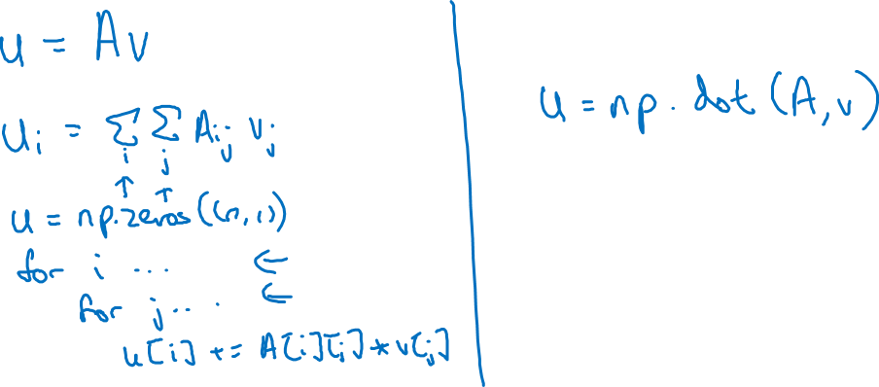
Neural network programming guideline
Whenever possible, avoid explicit for-loops.

Slide 32
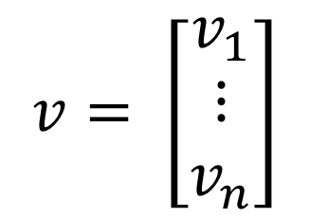
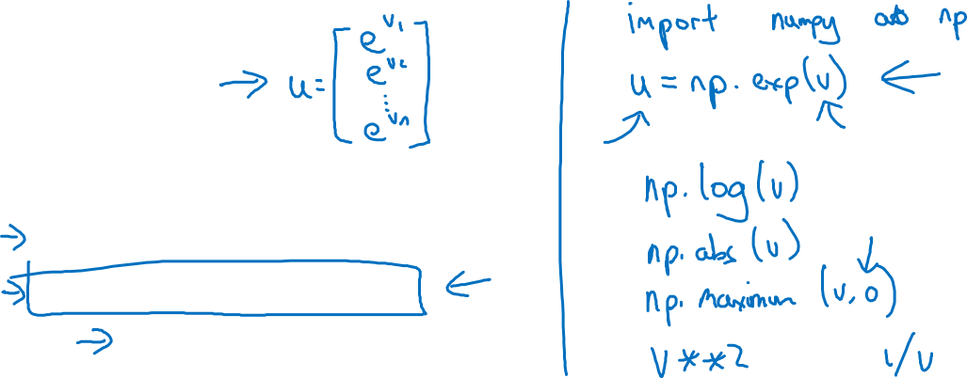
Vectors and matrix valued functions
Say you need to apply the exponential operation on every element of a matrix/vector.
$$v= \left[\begin{matrix}v_{1} \\ ⋮ \\ v_{n}\end{matrix}\right]$$
u = np.zeros((n,1))
for i in range(n):
u[i]=math.exp(v[i])

Slide 33

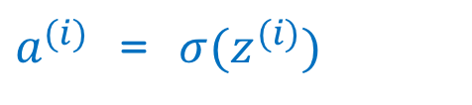





Logistic regression derivatives
J = 0, dw1 = 0, dw2 = 0, db = 0
for i = 1 to n:
$z^{(i)}$ = $w^{T}x^{(i)}+b$
$a^{(i)}$ = $σ{(z}^{(i)})$
$J$+= $−\left[y^{(i)} \log{{\hat{y}}^{\left(i\right)}+({1−y}^{\left(i\right)})\log{(1 −{\hat{y}}^{\left(i\right)})}}\right]$
d$z^{(i)}$ = $a^{(i)}{(1−a}^{(i)})$
d${w_{1}}^{ }$+= $x_{1}^{(i)}\text{d}z^{(i)}$
d${w_{2}}^{ }$+= $x_{2}^{(i)}\text{d}z^{(i)}$
db += d$z^{(i)}$
J = J/m, d$w_{1}$ = d$w_{1}$/m, d$w_{2}$ = d$w_{2}$/m, db = db/m

Slide 34
Basics of Neural Network Programming
Vectorizing Logistic
Regression
deeplearning.ai

Slide 35







Vectorizing Logistic Regression
$$z^{(1)}=w^{T}x^{(1)}+b$$
$$z^{(2)}=w^{T}x^{(2)}+b$$
$$z^{(3)}=w^{T}x^{(3)}+b$$
$$a^{(1)}={σ(z}^{(1)})$$
$$a^{(2)}={σ(z}^{(2)})$$
$$a^{(3)}={σ(z}^{(3)})$$

Slide 36
Basics of Neural Network Programming
Vectorizing Logistic
Regression’s Gradient
Computation
deeplearning.ai

Slide 37

Vectorizing Logistic Regression

Slide 38





Implementing Logistic Regression
J = 0, d$w_{1}$ = 0, d$w_{2}$ = 0, db = 0
for i = 1 to m:
$z^{(i)}$ = $w^{T}x^{(i)}+b$
$a^{(i)}$ = $σ{(z}^{(i)})$
$J$+= $−\left[y^{(i)} \log{a^{\left(i\right)}+({1−y}^{\left(i\right)})\log{(1 −a^{\left(i\right)})}}\right]$
d$z^{(i)}$ = $a^{(i)}{−y}^{(i)}$
d${w_{1}}^{ }$+= $x_{1}^{(i)}\text{d}z^{(i)}$
d${w_{2}}^{ }$+= $x_{2}^{(i)}\text{d}z^{(i)}$
db += d$z^{(i)}$
J = J/m, d$w_{1}$ = d$w_{1}$/m, d$w_{2}$ = d$w_{2}$/m
db = db/m

Slide 39
Basics of Neural Network Programming
Broadcasting in
Python
deeplearning.ai

Slide 40




Broadcasting example
Calories from Carbs, Proteins, Fats in 100g of different foods:
Apples
Beef
Eggs
Potatoes
Carb
$$\left[\begin{matrix}56.0 & 0.0 & \begin{matrix}4.4 & 68.0\end{matrix} \\ 1.2 & 104.0 & \begin{matrix}52.0 & 8.0\end{matrix} \\ 1.8 & 135.0 & \begin{matrix}99.0 & 0.9\end{matrix}\end{matrix}\right]$$
Protein
Fat
cal = A.sum(axis = 0)
percentage = 100*A/(cal.reshape(1,4))

Slide 41










Broadcasting example
$$\left[\begin{matrix}1 \\ \begin{aligned}\begin{matrix}2 \\ 3\end{matrix} \\ 4\end{aligned}\end{matrix}\right]$$
$$\left[\begin{matrix}101 \\ \begin{aligned}\begin{matrix}102 \\ 103\end{matrix} \\ 104\end{aligned}\end{matrix}\right]$$
$$100$$
=
+
$\left[\begin{matrix}1 & 2 & 3 \\ 4 & 5 & 6\end{matrix}\right]$
$$\left[\begin{matrix}100 & 200 & 300\end{matrix}\right]$$
$$\left[\begin{matrix}101 & 202 & 303 \\ 104 & 205 & 306\end{matrix}\right]$$
+
=
$\left[\begin{matrix}1 & 2 & 3 \\ 4 & 5 & 6\end{matrix}\right]$
$$\left[\begin{matrix}100 \\ 200\end{matrix}\right]$$
$$\left[\begin{matrix}101 & 102 & 103 \\ 204 & 205 & 206\end{matrix}\right]$$
+
=

Slide 42

General Principle

Slide 43
Basics of Neural Network Programming
A note on python/
numpy vectors
deeplearning.ai

Slide 44
Python Demo

Slide 45
Python / numpy vectors
import numpy as np
a = np.random.randn(5)
a = np.random.randn((5,1))
a = np.random.randn((1,5))
assert(a.shape = (5,1))

